Slide 1
Deep (and Wide) Contextual Bandits
Week 2 Demo | 29 Jan

Slide 2
👀 A (Very) Brief Basic Recap
The CB problem formulation
Observes a context (feature vector)
Chooses an action (categorical variable)
Receives corresponding reward (categorical/continuous variable)
Bandit setting: Can “see” reward only of picked action
Our problem
Given email campaign & user (context)
Choose to Send( =1)/not-send( =0) action
s.t. objective — open/unsub/revenue etc aka reward — is optimized
The idea is to maximize cumulative reward across run
Not easy — Explore-Exploit Dilemma, Algorithmic bias etc.

Slide 3
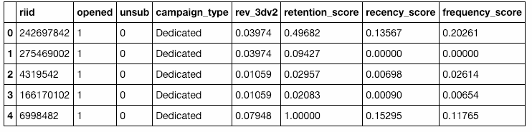
📋 Snippet Snapshot
~6.3M
rows
8 cols

Slide 4
🕵️ Investigating the Snippet
1
2
3
Highly Imbalanced
Default Behaviour Drives Many
Widely Different Feature Ranges
99% Unsub = 0
99% Revenue = 0
People who previously opened, likely to open next
Numeric columns (e.g. rev, recency score) have diff (min, max)

Slide 5
🕵️ Investigating the Snippet
1
2
3
Highly Imbalanced
Default Behaviour Drives Many
Widely Different Feature Ranges
99% Unsub = 0
99% Revenue = 0
People who previously opened, likely to open next
Numeric columns (e.g. rev, recency score) have diff (min, max)
Reward function
Additional User Feature
Min-max Scaling

Slide 6
🧬 Other Design Choices
One-hot encoding of categorical columns
2 possible ‘ground-truth’ reward distribution functions
Linear combination of open, unsub and revenue outcomes with neg bias term
Reduces for most instances to
Piecewise constants
By def, all data we can collect & have will be for Action=1 (Send)
Generate counterfactual data: (x, 1, r) ==> (x, 0, -r)
Rapid model iteration on 2 dataset types
Toy dataset from Space Bandits repo
Randomly sampled subsets from provided Data Snippet
Have not used consistent datasets across team -> Will be fixed

Slide 7

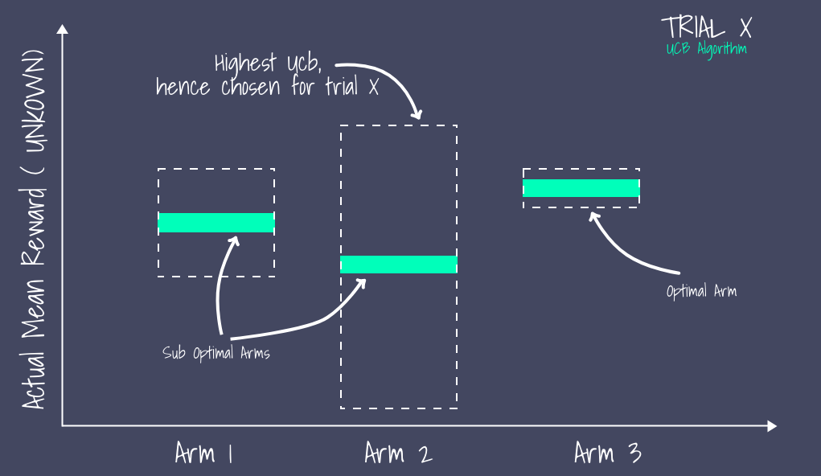
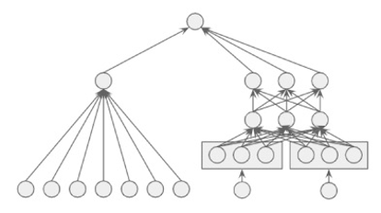
♟️The Models
Space Bandits
Linear UCB
Wide & Deep
(Baseline)
• Bayesian Linear Reg (Thompson Sampling) • NN + Bayesian Linear Reg
• Linear UCB
• Deep & Wide + Linear UCB
• (1) Wide, (2) Deep, (3) Wide & Deep
• Posterior/Point output paired with bandit algos

Slide 8
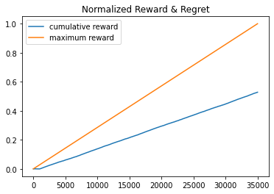
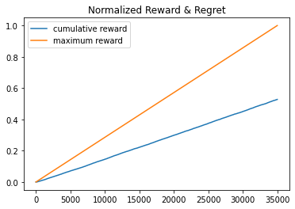
💯 Evaluation: Space Bandits on Snippet
(1) Bayesian Linear, (2) 2-layer [32, 16] FF NN + Bayesian Linear
Dataset used: 20% of the data snippet, randomly sampled, 80-20 split
Accuracy of both models: ~75 - 78%

Slide 9
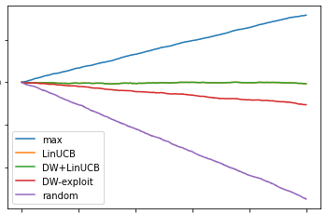
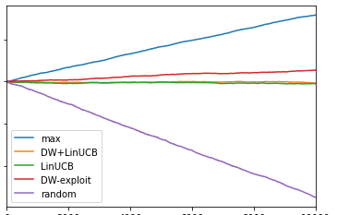
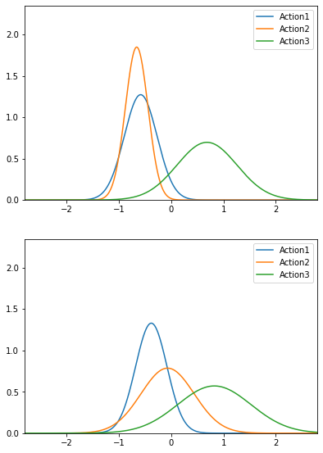
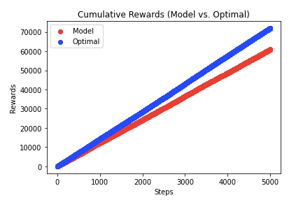
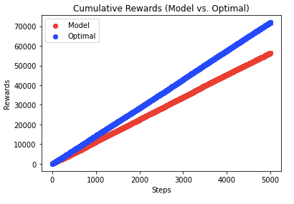
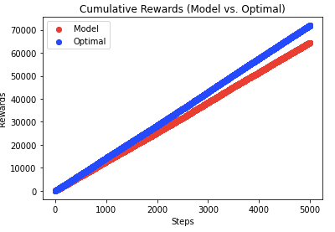
💯 Evaluation: LinUCB, W&D on Toy Dataset
Toy Data modeled in Space Bandits
2 customer types aka contexts
3 actions to choose from
Different customers prefer different actions
Validation Set
Training Set
LinUCB
W&D
ε (0.1) greedy
Wide
Deep
Wide & Deep

Slide 10
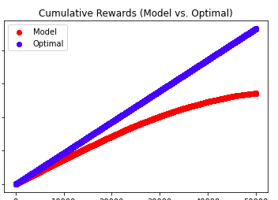
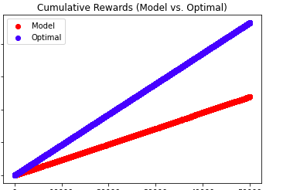
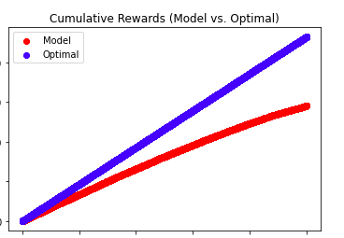
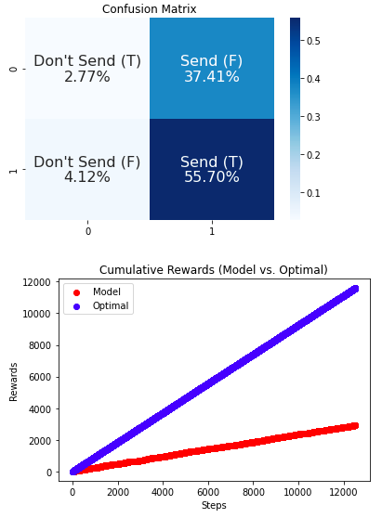
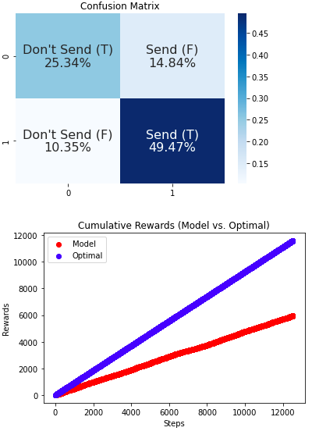
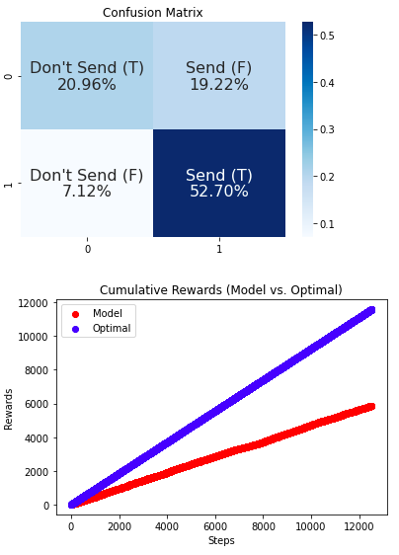
💯 Evaluation: W&D on Data Snippet
Wide
Deep
Wide & Deep
Training Set
Wide Model levels off because:
(1) fixed user dictionary size (2) “memorization” doesn’t kick in for users seen in latter part of training
Validation Set
Wide performs poorly because 90%+ valid set users not seen by model earlier
But send rewards higher in both train and valid <— W&D ↑accuracy than W or D

Slide 11

🤔 Next Steps
EDA Track
Gained access to complete dataset (70M+ rows, 64 cols) on Jan 27
EDA, data preprocessing, signal boosting, compute reward function, generate counterfactual data etc.
Model Improvement Track
More effective strategies to handle unseen users
Generating separate riid embeddings
Hyperparameter tuning
Model Collection & Implementation Track
More architectures
More architecture-bandit algo combinations
Process Track
Standardize collaboration work:
Dataset
Evaluation Metrics & Methods
Reward Functions
….

Slide 12
🙏 Thank you for listening!
✋ Any Questions?

